Slide 1
Law Day 2021

Slide 2
Advancing the Rule of Law, Now

Slide 3
What is the Rule of Law?
Notes:
Now-let’s begin with the fundamental question: what is the rule of law? There are many different definitions of the “rule of law” and many ways that lawyers, judges, and members of the public interpret this phrase. However, let’s frame the definition for our discussion today:

Slide 4
What is the Rule of Law?
The Rule of Law exists when a society administers itself through a set of transparent, fair rules which are applied by impartial adjudicators.
The purpose of the Rule of Law is to provide people with a government of security, predictability and reason.
Notes:
“The Rule of Law exists when a society administers itself through a set of transparent, fair rules, which are applied by impartial adjudicators.”
Let’s take a moment to break this down: we are talking about a society that “administers itself”—so that means a society that has some sort of structure that people follow—a government, for example. We are also talking about fair and transparent rules—so laws and regulations that are clear to the members of the society. And these rules are applied by “impartial adjudicators”– so the rules of the society are not just arbitrarily applied, but rather someone who is impartial—like a judge, applies the rules to every person and entity equally and fairly.
Further, “the purpose of the Rule of Law is to provide people with a government of security, predictability, and reason.” This here is key. The whole point of the “rule of law” is that it makes our lives predictable—we know what the laws are, we know that we have to follow them, and we expect everyone around us to be following those same laws. The Rule of Law allows us to live our lives with a feeling of security—we know what to expect when we walk out the front door each morning. We know what society expects of us, and we know what rules and laws are in place to protect us as we go about our daily lives.

Slide 5
What are examples of the Rule of Law in daily life?
Notes:
When you take a moment to think about it, the principles of the rule of law are apparent in many facets of our everyday lives. Many of our everyday activities are guided by the rule of law—let’s think about some examples.

Slide 6
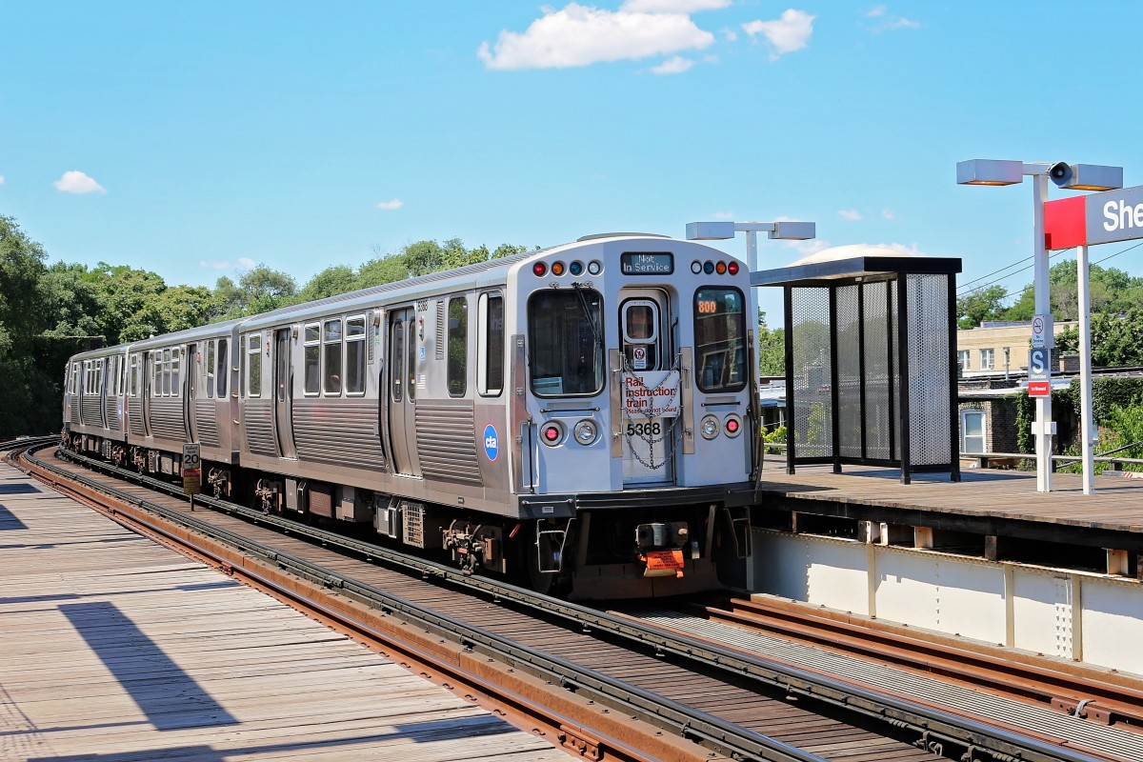
The Rule of Law in Daily Life
The Rule of Law affects our daily lives…
Grocery stores
Transportation
School
Sports
Internet and social media
Notes:
Here we can see a list of just a few of our routine, everyday activities that are structured and guided by rule of law principles. Let’s take the first one: grocery stores and think for just a moment about how that trip to the grocery store to pick up some milk and eggs is guided by the rule of law.
First consider how you get to the grocery store—maybe you drive, maybe you walk, maybe you take public transportation. However, regardless of how you get there, the rule of law plays a role. If you drive, you have to respect speed limits and road signs and other traffic laws. If you walk, you are relying on drivers to abide by the rule of law and stop at crosswalks so that you can safely cross the street. If you take public transportation, you are required by law to pay the fare for your trip and the bus or subway that you are riding must adhere to safety standards and regulations set by law.
The rule of law continues to guide your trip once you walk into the store. The items you see on the shelves are regulated for your safety. Food production companies have to follow rules and laws to ensure your safety as consumers. The advertising on the packaging is subject to the rule of law—packaging cannot be misleading about the ingredients in a product and nutritional information must be provided. We could go on and on about the grocery store and the ways that the rule of law impact the functioning of the store and your trip there, but I will let each of you think that through.
I won’t go through the other activities on this list at this time, but I encourage you to think through how driving, schools, sports, and the Internet and social media are impacted by the rule of law as you go about your daily lives.

Slide 7
Does the Rule of Law matter?
Notes:
So we have established that the Rule of Law is everywhere and has a tremendous impact on our daily lives—in fact, you could probably argue that it is because of the Rule of Law that we are able to go about our daily activities. But let’s take a minute to imagine an alternative universe to really determine if the Rule of Law matters…

Slide 8
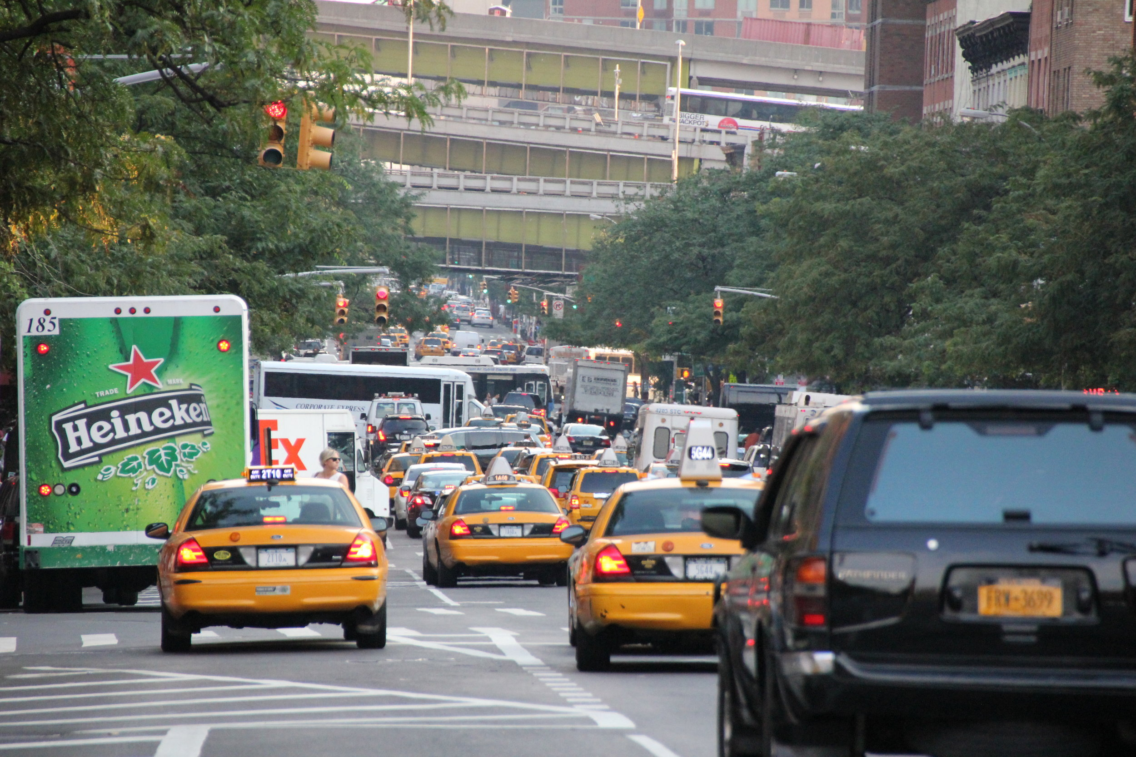
Does the Rule of Law matter?
Imagine if everyone in your community decided that they did not want to be bothered by traffic laws and signals, for example. What would happen?
Notes:
Let’s consider what would happen without the rule of law. Take the scenario on this slide for example—what would happen if everyone decided that traffic laws and signals no longer mattered and were no longer going to dictate how drivers behave.
Just imagine—no speed limits, no traffic lights, no stop signs, no signaling before changing lanes. I think we can all imagine the outcome of this scenario. In addition to what would likely be terrible gridlock, there would inevitably be more accidents, more casualties, and significantly more danger to getting behind the wheel. Consider also that this increased danger would not only be for drivers—but for pedestrians, passengers, bicyclists and anyone who happened to be near a moving vehicle.

Slide 9
The Global Impact of the Rule of Law
The World Justice Project studies the rule of law in different countries.
Countries with strong rule of law scores tend to have…
higher life expectancies,
greater economic growth and
less violence.
The World Justice Project (WJP) Rule of Law Index 2020, available at https://worldjusticeproject.org/sites/default/files/documents/WJP%20Insights%202020%20-%20Online%20.pdf
Notes:
As we think about the “Rule of Law,” it is important that we not only consider how the Rule of Law impacts our society, here in the United States, but also about how the Rule of Law operates around the world.
The World Justice Project, which studies the rule of law in different countries, has found that countries with strong “rule of law scores” – so countries that adhere to the rule of law principles that we will be diving into in just a few minutes, have: higher life expectancies, greater economic growth, and less violence. The rule of law truly does have a global impact.

Slide 10
The World Justice Project (WJP) Rule of Law Index 2020, available at https://worldjusticeproject.org/sites/default/files/documents/WJP%20Insights%202020%20-%20Online%20.pdf
Notes:
So here we have a map of the world—and what the colors show are rule of law “scores.” If you look at the scale on the top right of the slide, you will see that countries that have higher adherence to the rule of law are the green shades, those in the middle are orange and yellow, and low adherence to the rule of law is reflected with pink and red colors.
You can see the United States is shaded a lighter green color—Canada and Australia as well as parts of Europe are ranked higher in their rule of law adherence according to the World Justice Project. While we will not delve into the ranking scale here today, I encourage you to conduct your own research into how the rankings are given and what implication they have.

Slide 11
Rule of Law Principles
Notes:
Now that we have considered how the Rule of Law impacts our everyday lives and the global impact of the Rule of Law, let’s delve a bit deeper into four rule of law principles that will really help us to understand the importance of the Rule of Law to our society and the functioning of our government.

Slide 12
Roadmap: Four Rule of Law Principles
The judiciary is independent. Judges and courts are fair and impartial.
Laws are shared openly and enforced fairly.
The same laws apply to everyone. Everyone is treated equally under the law.
Government power is constrained by publicly promulgated laws.
Notes:
We will be touching on four Rule of Law principles today—and I should note that our discussion today is just an overview. You could write a whole book on each of these principles--and people have. In any event, the four principles we will cover today are:
-an independent judiciary—judges and courts are fair and impartial.
-laws are shared openly and enforced fairly
-the same laws apply to everyone. Everyone is treated equally under the law. AND
-government power is constrained by publicly promulgated laws
For each principle, we will begin by exploring quotes from judges, legal experts, and others to gain an understanding of what the principle means. We will then briefly review a landmark case from the United States Supreme Court that addresses the principle, before considering takeaways and discussion questions.

Slide 13
Principle One An Independent Judiciary and Fair and Impartial Judges
Notes:
First up: Principle One: an independent judiciary and fair and impartial judges. We are going to see what three Supreme Court Justices have said about the role of an independence judiciary to help us understand the importance of an independent judiciary to the “rule of law.”

Slide 14
Principle One: An Independent Judiciary and Fair and Impartial Judges
Justice Felix Frankfurter
Associate Justice of the Supreme Court, in office 1939-1962
“There can be no free society without law administered through an independent judiciary. If one man can be allowed to determine for himself what is law, every man can. That means first chaos, then tyranny. Legal process is an essential part of the democratic process.”
United States v. United Mine Workers (1947)
Notes:
Justice Felix Frankfurter, an Associate Justice of the Supreme Court from 1939 to 1962, wrote that “There can be no free society without law administered through an independent judiciary. If one man can be allowed to determine for himself what is law, every man can. That means first chaos, than tyranny. Legal process is an essential part of the democratic process.”

Slide 15
Principle One: An Independent Judiciary and Fair and Impartial Judges
Justice Sandra Day O’Connor
Associate Justice of the Supreme Court, in office 1981-2006
“The founders realized there has to be some place where being right is more important than being popular or powerful and where fairness trumps strength. And, in our country, that place is supposed to be the courtroom.”
Interview with NPR (January 16, 2010), available at https://www.npr.org/templates/story/story.php?storyId=122993740
Notes:
In an interview with NPR in 2010, Justice Sandra Day O’Connor, Associate Justice from 1981 to 2006 stated “The founders realized there has to be some place where being right is more important than being popular or powerful and where fairness trumps strength. And, in our country, that place is supposed to be the courtroom.”

Slide 16
Principle One: An Independent Judiciary and Fair and Impartial Judges
Justice Brett Kavanaugh
Associate Justice of the United States Supreme Court, in office 2018-present
“…a judge must be independent, not swayed by public pressure. Our independent judiciary is the crown jewel of our constitutional republic. The Supreme Court is the last line of defense for the separation of powers, and for the rights and liberties guaranteed by the Constitution.”
Wall Street Journal Editorial (October 4, 2018), available at https://www.wsj.com/articles/i-am-an-independent-impartial-judge-1538695822
Notes:
Finally, Justice Brett Kavanaugh, current Associate Justice recently stated “… a judge must be independent, not swayed by public pressure. Our independent judiciary is the crown jewel of our constitutional republic. The Supreme Court is the last line of defense for the separation of powers, and for the rights and liberties guaranteed by the Constitution.”

Slide 17
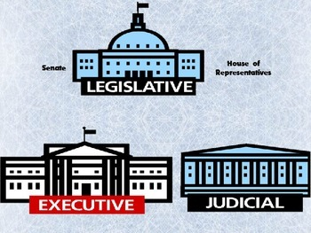
Case Study: Marbury v. Madison (1803)
An independent judiciary is now considered fundamental to the rule of law. But that was not always the case…
The Constitution does not say explicitly that a court can strike down a law passed by Congress and signed by the President.
Marbury v. Madison was the first case in which the United States Supreme Court decided that a law passed by Congress and signed by the President was unconstitutional and had to be invalidated.
This established the principle of “Judicial Review”
Federal courts have the power to decide if a law is constitutional or not.
Notes:
Marbury v. Madison is perhaps one of the most famous cases in all of United States legal history. It is one of the first cases that first year law students study—ask any lawyer, and they will likely remember discussing this case in law school.
The reason that this case is so famous and is a pillar of legal education is that it clearly and unequivocally highlights the first rule of law principle—an independent and impartial judiciary that can decide whether a law is constitutional or not. Marbury v. Madison articulates what the Constitution does not – that the independent judiciary can strike down a law passed by Congress and signed by the President—what is commonly called “judicial review.”

Slide 18
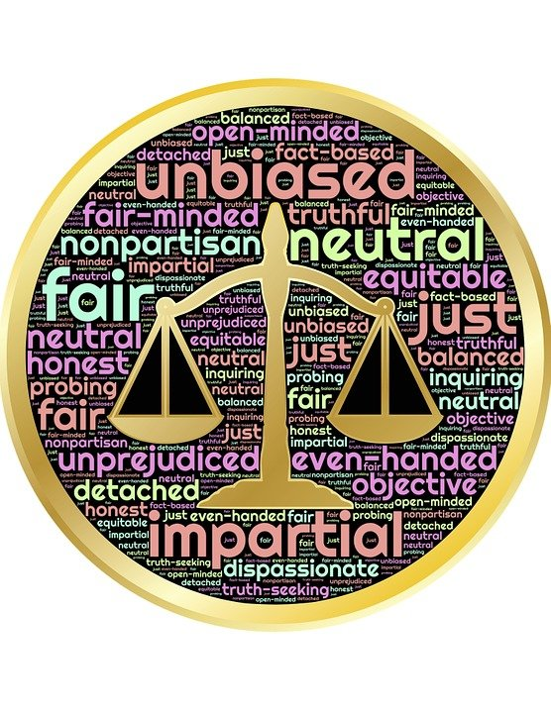
Key Takeaways: An Independent Judiciary and Fair and Impartial Judges
In an independent judiciary, a judge is free to weigh facts and the law to make decisions on cases without outside pressure.
Judges make decisions independent of politics or personal views.
Because judges do not face the political pressures, it is easier for them to make unpopular decisions when the law requires it.
In the courtroom, the merits of one’s position are determinative.
Notes:
So here we have our key takeaways about our first Rule of Law principle: an independent judiciary and fair and impartial judges:
In an independent judiciary, a judge is free to weigh facts and the law to make decisions on cases without outside pressure
Judges make decisions independent of politics or personal views
Because judges do not face political pressures, it is easier for them to make unpopular decisions when the law requires it
In the courtroom, the merits of one’s position are determinative → not the status of the litigant or the popularity of his or her position.

Slide 19
Key Takeaways: An Independent Judiciary and Fair and Impartial Judges
The public has a right to access court proceedings and know how cases are decided.
People can attend trials and hearings and request copies of court records and documents.
Judicial opinions are published, so people can understand how a decision was made.
There are established, transparent processes for selecting judges.
Notes:
Further,
The public has a right to access court proceedings and know how cases are decided—our justice system is carried out transparently, adding a layer of public accountability to the process
People can attend trials and hearings and request copies of court records and documents
Judicial opinions are published, so people can understand how a decision was made
There are established, transparent processes for selecting judges
Each of these takeaways highlights an aspect of our independent judiciary, comprised of fair and impartial judges, that are essential to our legal system and the Rule of Law in the United States. Consider these takeaways as you think about the discussion questions on the next slide:

Slide 20
Questions for Discussion
Would it be a problem if everyone could determine the law for themselves?
Do you agree with Justice O’Connor that it is more important to be right than to be powerful in the courtroom?
Can you identify a challenge we face in maintaining an independent judiciary?
Notes:
LEAVE SLIDE UP for 30 seconds? (No need to read the questions)

Slide 21
Principle Two Openly Shared and Fairly Enforced Laws
Notes:
We will now move on to the second Rule of Law Principle: “Openly Shared and Fairly Enforced Laws.”
This principle highlights another fundamental pillar of our society: the laws we are expected to follow are clear and publicly promulgated and are fairly enforced—the law is applied equally to all.

Slide 22
Principle Two: Openly Shared and Fairly Enforced Laws
Jeremy Waldron
Professor of Law and Philosophy, NYU
“Law should be a body of norms promulgated as public knowledge so that people can study it, internalize it, figure out what it requires of them, and use it as a framework for their plans and expectations and for settling their disputes with others.”
The Rule of Law, Stanford Encyclopedia of Philosophy (2016)
Notes:
Jeremy Waldron, Professor of Law and Philosophy at New York University, writes the following about this principle:
“Law should be a body of norms promulgated as public knowledge so that people can study it, internalize it, figure out what it requires of them, and use it as a framework for their plans and expectations and for settling their disputes with others.”

Slide 23
Principle Two: Openly Shared and Fairly Enforced Laws
Dr. Martin Luther King, Jr.
Baptist Minister and Civil Rights Activist
“Sometimes a law is just on its face and unjust in its application. For instance, I have been arrested on a charge of parading without a permit. Now, there is nothing wrong in having an ordinance which requires a permit for a parade. But such an ordinance becomes unjust when it is used to maintain segregation and to deny citizens the First-Amendment privilege of peaceful assembly and protest.”
Letter from a Birmingham Jail (1963)
Notes:
Dr. Martin Luther King, Jr. highlighted another component of this Rule of Law principle, noting that while sometimes a law seems fair when you read it, laws can be applied unfairly.
He wrote in Letter from a Birmingham Jail, “Sometimes a law is just on its face and unjust in its application. For instance, I have been arrested on a charge of parading without a permit. Now, there is nothing wrong in having an ordinance which requires a permit for a parade. But such an ordinance becomes unjust when it is used to maintain segregation and to deny citizens the First-Amendment privilege of peaceful assembly and protest.”

Slide 24
Case Study: Bouie v. City of Columbia (1964)
In 1960, two black students from a nearby university sat down for lunch at a segregated diner in Columbia, SC.
Diner employees then put up a “no trespassing” sign.
The students continued to sit quietly at their booth, and were subsequently arrested for trespassing and convicted.
Previously, South Carolina’s criminal trespass law prohibited only unauthorized entry, but not remaining on premises after receiving notice to leave, as the students had done.
But in 1961, the year after their arrest, the South Carolina Supreme Court expanded the interpretation of the law to cover the students’ conduct.
The U.S. Supreme Court struck down their convictions, holding that broadening criminal liability in this way violated due process.
Ex post facto laws, that seek to punish people after the fact, are not consistent with the principle that laws be publicly promulgated, i.e., that people know what laws they are subject to.
Notes:
The case of Bouie v. City of Columbia, illustrates the principle that laws must be openly shared and publicly promulgated in order to be enforced.
In this case, Black students sat down for lunch at a segregated diner in South Carolina, and remained in the diner after the diner employees put up a “no trespassing” sign. The students were arrested under South Carolina’s criminal trespass law, which at the time of their arrest, prohibited only unauthorized entry, but not remaining on premises after receiving notice to leave.
The year AFTER the students’ arrest, the South Carolina Supreme Court expanded the interpretation of the criminal trespass statute to include BOTH unauthorized entry and remaining on premises after receiving notice to leave.
However, the United States Supreme Court struck down the students’ convictions, holding that broadening criminal liability after the conduct occurs--or seeking to punish conduct after the fact, violates due process and is not consistent with the principle that laws be publicly promulgated. In other words, at the time the students remained in the diner, there was no way they could have known that their conduct was considered against the law—that interpretation of the criminal trespass statute had not been publicly promulgated and openly shared with the public at the time of their arrest.

Slide 25
Key Takeaways: Openly Shared and Fairly Enforced Laws
The federal government enacts, or promulgates, many laws that affect our lives.
Congress must pass a bill through both the House and Senate.
Once a bill is passed by Congress and signed by the President, it becomes a federal law.
Notes:
Let’s now review the takeaways from our second Rule of Law principle, beginning with the process by which laws are made:
-The federal government enacts, or promulgates, many laws that affect our lives.
-Congress must pass a bill through both the House and Senate.
-Once a bill is passed by Congress and signed by the President, it becomes a federal law.

Slide 26
Key Takeaways: Openly Shared and Fairly Enforced Laws
All federal laws are publicly available, and anyone can look them up and read them.
All laws are available in the Federal Register, and can be easily accessed online.
Laws must be publicly available so that people are aware of them and know how to follow them.
Notes:
Once laws are created:
-All federal laws are publicly available, and anyone can look them up and read them.
-All laws are available in the Federal Register, and can be easily accessed online.
-Laws must be publicly available so that people are aware of them and know how to follow them.

Slide 27
Key Takeaways: Openly Shared and Fairly Enforced Laws
Secret laws or laws that are unfairly enforced undermine public confidence in government and the rule of law.
Laws must be fair not only in theory, but in practice as well. Laws that are enforced only against a subset of the population may look fair on paper, but in reality they are not.
Notes:
Further,
-Secret laws or laws that are unfairly enforced undermine public confidence in government and the rule of law.
-Laws must be fair not only in theory, but in practice as well. Laws that are enforced only against a subset of the population may look fair on paper, but in reality they are not.
I now encourage you to consider the following questions for discussion:

Slide 28
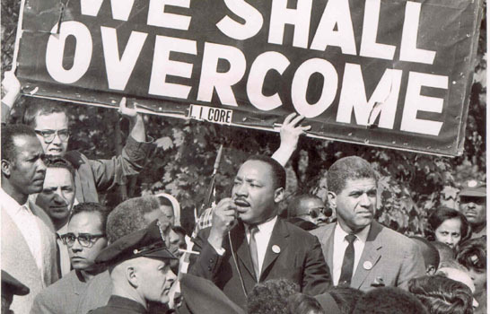
Questions for Discussion
Can you think of a law that appears fair, but is enforced in a way that makes it unfair?
Do you think it is fair if a person is punished for breaking a law the person does not know about?
Notes:
Show slide for a minute (no need to read questions).

Slide 29
Principle Three Equal Treatment under the Law
Notes:
Let’s move onto our third Rule of Law principle: equal treatment under the law.

Slide 30
Principle Three: Equal Treatment under the Law
Theodore Roosevelt
26th President of the United States, in office 1901-1909
“A republic such as ours can exist only by virtue of the orderly liberty which comes through the equal domination of the law over all men alike, and through its administration in such resolute and fearless fashion as shall teach all that no man is above and no man below it.”
“A Square Deal” Speech (1903)
Notes:
In a 1903 speech, President Theodore Roosevelt discussed the Rule of Law principle that there must be equal treatment under the law. He stated, “A republic such as ours can exist only by virtue of the orderly liberty which comes through the equal domination of the law over all men alike, and through its administration in such resolute and fearless fashion as shall teach all that no man is above and no man below it.”

Slide 31
Principle Three: Equal Treatment under the Law
Janai Nelson
Associate Director-Counsel, NAACP Legal Defense Fund
“And the rule of law is really central to this fight for racial justice because, you know, at bottom, the rule of law is about consistency and fairness and accountability at all levels of government.”
The Rule of Law Reimagined (2020)
Notes:
Equal treatment under the law remains at the forefront of our discussion of the “rule of law” in our society today. Janai Nelson, Associate Director-Counsel at the NAACP Legal Defense Fund, in discussing racial justice issues notes: “And the rule of law is really central to this fight for racial justice because, you know, at bottom, the rule of law is about consistency and fairness and accountability at all levels of government.”
This quote highlights important aspects of the equal treatment under law principle: consistency, fairness, and accountability. Each of these is critical to ensuring equal treatment under the law.

Slide 32
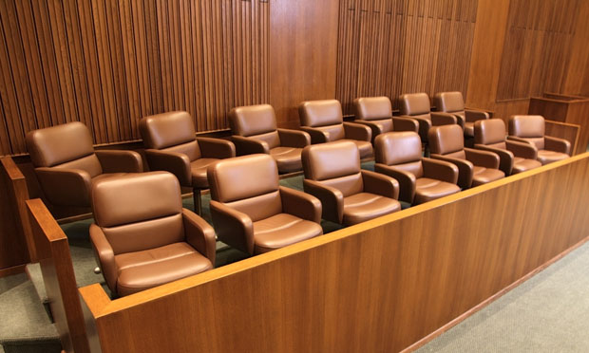
Case Study: Batson v. Kentucky (1986)
The United States Supreme Court held that no citizen can be denied the right to serve on a jury based on race.
A defendant in a criminal case can make a constitutional Equal Protection claim based on the discriminatory use of peremptory challenges at a trial.
Once the defendant makes a showing that race was the reason that potential jurors were excluded, the burden shifts to the state to come forward with a race-neutral explanation for the exclusion.
Notes:
The landmark Supreme Court case of Batson v. Kentucky highlights the equal treatment under law principle. In this case, the Supreme Court held that no citizen can be denied the right to serve on a jury based on race.
To explain in a bit more depth: during jury selection, lawyers can exercise what is called a “peremptory challenge” to exclude a potential juror without having to provide a reason. However, in the Batson case, the Supreme Court made clear that a juror’s race cannot be the reason for excluding him or her from the jury panel—and that if a defendant can make a showing that race was the reason potential jurors were excluded, the government must then provide a race-neutral reason for their exclusion.

Slide 33
Key Takeaways: Equal Treatment under the Law
Equal treatment under the law is a cornerstone of a free society.
No individual is above the law.
Historically, some of the most serious abridgements of civil rights violated this principle, such as laws that treated people differently according to their race, sex, religion, disability, national origin or other characteristic.
Notes:
This brings us to our key takeaways about our third Rule of Law principle:
-Equal treatment under the law is a cornerstone of a free society.
-No individual is above the law.
-Historically, some of the most serious abridgements of civil rights violated this principle, such as laws that treated people differently according to their race, sex, religion, disability, national origin or other characteristic.
Now consider the following questions for discussion:

Slide 34
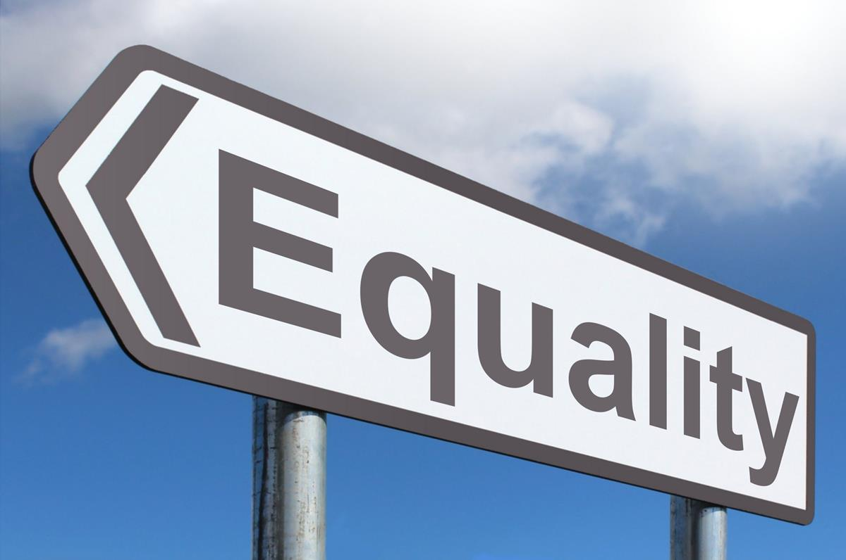
Questions for Discussion
Why is the fair and consistent application of laws an important idea?
Does equal treatment under the law strengthen our country?
Notes:
Leave for 30 seconds. No need to read questions.

Slide 35
Principle Four Government Power Is Constrained by Publicly Promulgated Laws
Notes:
We will now move on to the final principle – “Government Power is Constrained by Publicly Promulgated Laws.”
This is a fundamental pillar of our society – the government does not have unlimited power, nor do we have a form of government where the power is concentrated in one person or a few individuals such as in a monarchy. Rather, the founders of our country wanted to ensure that our system of government would not replicate the one in England, with an all-powerful monarch.
Let us take a look at what some political theorists had to say about this principle during the years of the American Revolution:

Slide 36
Principle Four: Government Power Is Constrained by Publicly Promulgated Laws
Thomas Paine
Political theorist and writer during the American Revolution, 1774-1783
“But where, say some, is the king of America? … In America the Law is King. For as in absolute governments the King is law, so in free countries the law ought to be King; and there ought to be no other.”
Common Sense (1776)
Notes:
Thomas Paine, political theorist and writer during the American Revolution, wrote: “But where, say some, is the king of America? … In America the Law is King. For as in absolute governments the King is law, so in free countries the law ought to be King; and there ought to be no other.”
Paine highlighted here the principle that the government of the United States would be one constrained by laws—he emphasized that in free countries, the LAW is king, not an individual.

Slide 37
Principle Four: Government Power Is Constrained by Publicly Promulgated Laws
James Madison
Political theorist, writer and Fourth President of the United States, in office 1809-1817
“If men were angels, no government would be necessary. In framing a government which is to be administered by men over men, the great difficulty lies in this: you must first enable the government to control the governed; and in the next place oblige it to control itself.”
The Federalist Papers, Paper No. 51 (1788)
Notes:
Similarly, James Madison, one of our Founding Fathers, wrote in Paper No. 51 of the Federalist Papers that “If men were angels, no government would be necessary. In framing a government which is to be administered by men over men, the great difficulty lies in this: you must first enable the government to control the governed; and in the next place oblige it to control itself.”
Here, Madison emphasizes the need for controls on the government – it cannot have unlimited powers over the people that it governs.

Slide 38
Case Study One: Spiro Agnew
Agnew was the Vice President from 1969 until 1973.
In 1972, he became the subject of a criminal investigation into corruption, which uncovered evidence of wrongdoing on his part during and after his tenure as an elected official in Maryland.
Agnew pleaded “nolo contendere” to tax evasion, and resigned the office of Vice President.
This shows that even someone with a job as important as the Vice President is not above the law.
Notes:
Let us consider what happened with Spiro Agnew to explore how this principle operates.
Agnew was the Vice President of the United States under Richard Nixon and was serving in that capacity when he became the subject of a criminal investigation of corruption, which uncovered wrongdoing during and after his tenure as an elected official in Maryland. He pleaded “nolo contendere” to the charge, which means that he accepted conviction as though a guilty plea has been entered, but did not admit guilt.
This situation demonstrates that not even the Vice President, second in command for the nation, is above the law. Government officials are obligated to follow the law in the same manner as the general public—a critical component of ensuring that government power is constrained by law.

Slide 39
Case Study Two: United States v. Peewee Coal (1951)
During WWII, the workers at the Peewee Coal Company went on strike, halting the production of coal.
The United States government seized the private coal company on May 1, 1943, and retained it until October 12, 1943. The seizure was intended to ensure that enough coal was produced for the war effort without interruption.
The government then ordered Peewee Coal to increase the workers’ wages.
The United States Supreme Court held that the seizure of Peewee Coal was an unconstitutional taking, and ordered the government to compensate the company for the value of the property’s use during the seizure.
Notes:
For our final case study, let us take a look at United States v. Peewee Coal.
In this case, the workers at the Peewee Coal company went on strike during World War II, which halted the production of coal. The government seized the coal company, intending to ensure that enough coal was produced for the war effort.
Ultimately, the United States Supreme Court held that seizing the coal company was an “unconstitutional taking,” in violation of the 5th Amendment to the Constitution, and ordered the government to compensate the company for the value of the property’s use during the seizure.
Here too is an example of the United States government being constrained by law. This case illustrates that the government cannot simply act with boundless and unchecked power—rather the law of the land controls even the federal government.

Slide 40
Key Takeaways: Government Power Is Constrained by Publicly Promulgated Laws
The Fifth Amendment to the Constitution states: “[N]or shall private property be taken for public use, without just compensation.”
This means that the government cannot take a person’s home or other property without paying the person a fair value for the property.
This is an example of a constraint on the government’s actions that requires it to treat property owners fairly.
Notes:
So let us review what we have learned about the constraints on government power as a “Rule of Law” principle, starting with the Fifth Amendment:
-The Fifth Amendment to the Constitution states: “[N]or shall private property be taken for public use, without just compensation.”
-This means that the government cannot take a person’s home or other property without paying the person a fair value for the property.
-This is an example of a constraint on the government’s actions that requires it to treat property owners fairly.

Slide 41
Key Takeaways: Government Power Is Constrained by Publicly Promulgated Laws
The government itself is bound by the rule of law.
Government officials must follow the law.
A government that is not constrained by the rule of law is a tyranny, and would be able to infringe the civil rights of its citizens.
Notes:
Further, we have learned that:
-The government itself is bound by the rule of law.
-Government officials must follow the law.
-A government that is not constrained by the rule of law is a tyranny, and would be able to infringe the civil rights of its citizens.
Now consider the following discussion questions:

Slide 42
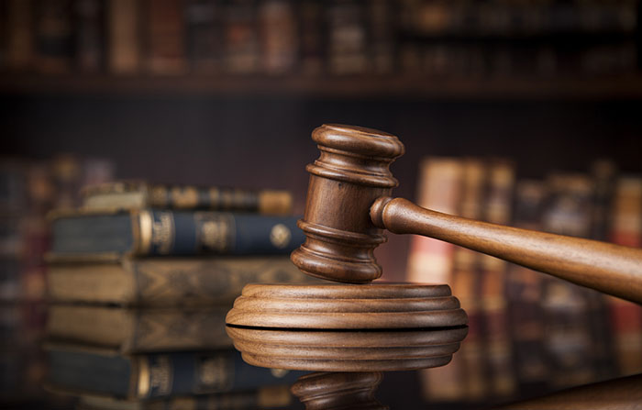
Questions for Discussion
What does it mean for “law to be king”?
How would you feel if the government could do whatever it wanted, whenever it wanted, to whomever it wanted?
Why is it important for the government to be restrained by law and rules?
Notes:
Leave for 30 seconds. No need to read questions.

Slide 43
The Rule of Law in the COVID-19 Pandemic
School closures
Limits on in-person activities and extracurriculars
Remote learning and working
Business closures and new public health requirements
Restrictions on dining, gyms, theaters, religious gatherings, funerals
Mask mandates
Eviction bans
Curfews
Travel restrictions
Quarantine requirements
Notes:
Now that we have explored the meaning and importance of the “Rule of Law” and the four major Rule of Law principles, it is interesting to consider the impact of the Rule of Law in our lives—particularly in the context of the COVID-19 pandemic, which has altered all of our lives for the past year. This list demonstrates only some of the ways that life has changed since March of 2020 due to the pandemic.
From school closures to restrictions on restaurant capacities and religious gatherings to mask mandates to quarantine requirements –the “Rule of Law” has been implicated throughout the COVID-19 pandemic.

Slide 44
How has the Rule of Law affected your life during the pandemic?
Notes:
Consider what you have learned today about the “Rule of Law” and how it is has affected your life during the pandemic.

Slide 45
Acknowledgments
Thank you to all of the contributors to this presentation, including:
Saul Shapiro, Jason Vitullo, Gautam Rao, Hyatt Howard and Lauren Richardson of Patterson Belknap Webb & Tyler LLP
Second Circuit Staff, including Adriana Mark, Alana Chill, Natasha Gohil, and Peter D’Antonio
Justice For All (JFA): Courts and Community Civic Education & Speakers Bureau Subcommittee Co-Chair Magistrate Judge Vera M. Scanlon
Law Day Subcommittee Chairs District Judge Mae D’Agostino and Saul Shapiro
Notes:
With that, I want to thank you for participating in this year’s Law Day celebration. I hope you have all enjoyed learning about the “Rule of Law” and that you will now have an increased appreciation for the Rule of Law as you go about your daily activities and routines.
We hope to welcome you to the Thurgood Marshall United States courthouse in person in the near future!

Slide 46
Contact Us
https://justiceforall.ca2.uscourts.gov/

Slide 47
Images Cited
The following images are licensed by Creative Commons:
Slide 6:
Grocery Store Photo: This Photo by Unknown Author is licensed under CC BY-NC-ND
Football Photo: This Photo by KeithJJ is licensed under CC0/Public Domain
Classroom Photo: This Photo by Unknown Author is licensed under CC BY
Train Photo: This Photo by Unknown Author is licensed under CC0/ Public Domain
Social Media Logos Graphic: This Photo by Unknown Author is licensed under CC BY - NC
Slide 8:
Traffic Photo: This Photo by Unknown Author is licensed under CC BY-SA
Slide 17:
Three Branches of Government Graphic: This Photo by Unknown Author is licensed under CC BY
Slide 18:
Impartial Scales of Justice Graphic: This Photo by Unknown Author is licensed under CC0/ Public Domain
Slide 28:
“We Shall Overcome” Photo: This Photo by Unknown Author is licensed under CC BY

Slide 48
Images Cited
The following images are licensed by Creative Commons:
Slide 32:
Jury Chairs Photo: This Photo by Unknown Author is licensed under CC BY-ND
Slide 34:
Equality Image: This Photo by Unknown Author is licensed under CC BY-SA
Slide 42:
Crown Graphic: This Photo by Unknown Author is licensed under CC BY-NC
Gavel Graphic: This Photo by Unknown Author is licensed under CC BY-NC-ND
Slide 43:
Coronavirus Graphic: This Photo by Unknown Author is licensed under CC BY-NC-ND
Johns Hopkins COVID-19 Dashboard Image: This Photo by Unknown Author is licensed under CC BY-SA
Mask Photo: This Photo by Unknown Author is licensed under CC BY-SA

